Slide 1

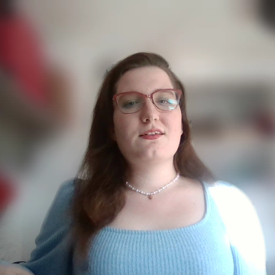
Task Manager Maui Application
Notes:
Welcome to the presentation of my Task Manager Application, which was designed to help users manage their time efficiently in everyday life through an intuitive interface.

Slide 2
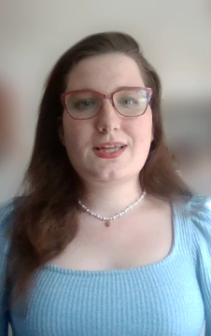
AGENDA
INTRODUCTION
Demo of Features
Technical Details
VISUAL AIDS
Challenges and Solutions
Conclusion
Notes:
The structure of my presentation is as follows:
Introduction: A quick overview of the project and myself.
Demo: A short video showcasing the application's features.
Technical Details: A deeper dive into the architecture, technologies, and testing process.
Visual Aids: The thought process behind the application's design and interface.
Challenges and Solutions: The obstacles I faced and how I overcame them during this assignment.
Conclusion: Wrapping up my journey with the project, including what I’ve learned and what went well.
I’ll also share some personal reflections on how this journey shaped me in both professional and personal aspects.

Slide 3
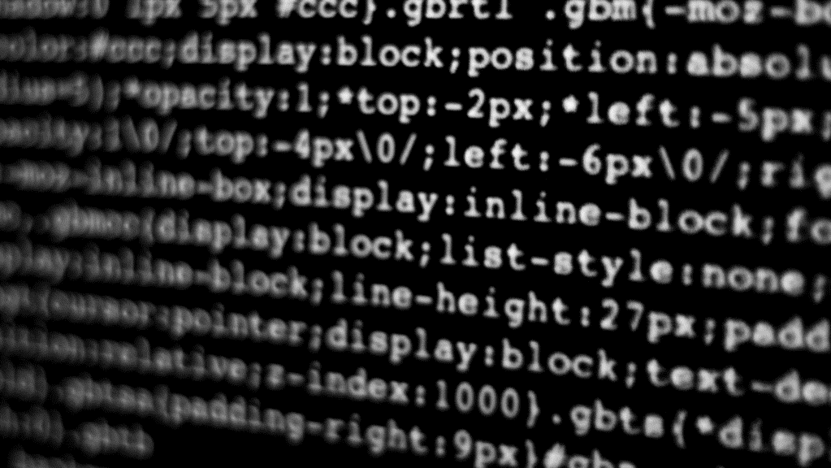
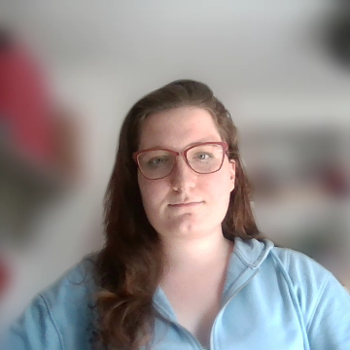
Introduction
Notes:
My name is Virág Szabó, and this is my final assignment for the C#2 course at NHL Stenden.
I’ve developed a Task Manager application to help users efficiently organize their daily tasks.
The project is built using C# with WPF for the interface and the .NET Framework for backend functionalities.
In this presentation, I’ll showcase the application's features, discuss its technical implementation, and reflect on the development process.
Let’s dive in!

Slide 4

Demo
The features of the application
Notes:
Here’s a quick demo of my application, highlighting its key features:
Task List Creation: Demonstrate how users can quickly create new task lists using the button.
Task List View: Show the main task list interface where tasks are listed and can be sorted or categorized.
Task Creation: Demonstrate how users can quickly create new task using the form.
Task Management: Edit or delete tasks to illustrate the flexibility of the application.

Slide 5
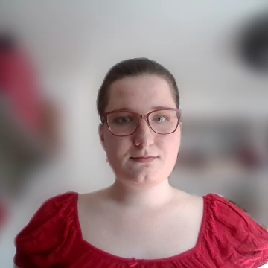
Technical Details
Notes:
Let’s dive into the technical details.

Slide 6
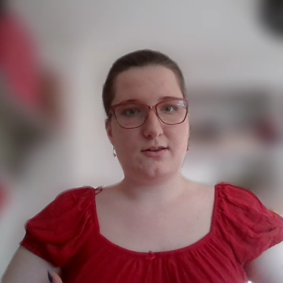
🛠️ Under the Hood 🛠️
SECTION | DETAILS
Architecture | UI Layer – Built using WPF, allowing modern and responsive UR interaction. Business Logic Layer – Handles core logic: task creation, updates, and completion. Data Layer – Uses .NET for persistent storage and export functionality.
Code Snippets | Task Management – Make new lists, also tasks that can be modified and removed. Status Updates – Tasks can be marked completed, progressed, or pended. Priority Updates – Tasks can be marked high, medium, or low. Download Feature – Tasks and lists are printed and saved into a file.
Testing | Unit Tests for extensive validation to validate, edit, complete and save tasks and lists.
Notes:
Architecture:
The Task Manager application follows a layered architecture, which ensures modularity and scalability.
Here’s a breakdown of the key layers:
UI layer: The user interface is built using WPF (Windows Presentation Foundation), chosen for its ability to create modern, responsive, and visually appealing interfaces. It allows users to interact intuitively with features like task creation, editing, and managing task lists.
Business logic layer: This layer is responsible for handling the application’s core logic. It ensures clean task management processes, such as adding tasks to lists, marking tasks as complete, and updating task statuses.
Data layer: Persistent storage is managed using .NET technologies, ensuring secure and efficient handling of user data. This layer supports features like saving tasks and lists, and exporting them for external use, such as printing.
Code Snippets:
Task Management:
Users can create, delete, and edit tasks directly through the interface.
Additionally, they can create task lists, such as a cleaning schedule for the day, and assign individual tasks to these lists.
Task Status Updates:
Tasks can be marked as completed, keeping users updated on their progress.
Download Feature:
Users can download their tasks and task lists, making it easy to print or save them for offline use.
Testing
Testing not only gave me confidence in the application’s stability but also highlighted areas for improvement during development.
To ensure the reliability of the application, I extensively used unit tests within Visual Studio to validate all critical functionalities and classes.
This includes testing task creation, editing, deletion, and task list management.
The tests helped catch potential issues early and ensured that the app operates as expected under various scenarios.
For example, unit tests were written to:
Verify that tasks are correctly added to task lists.
Check if tasks can be marked as completed and saved accurately.
Ensure the download functionality produces the expected output.

Slide 7
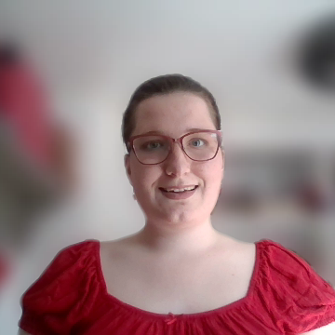
Visual Aids
Notes:
Next, let’s looking at the design of the application.

Slide 8
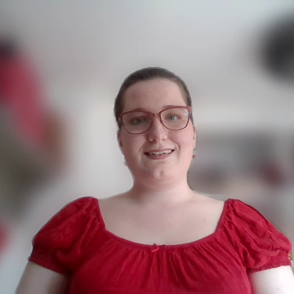
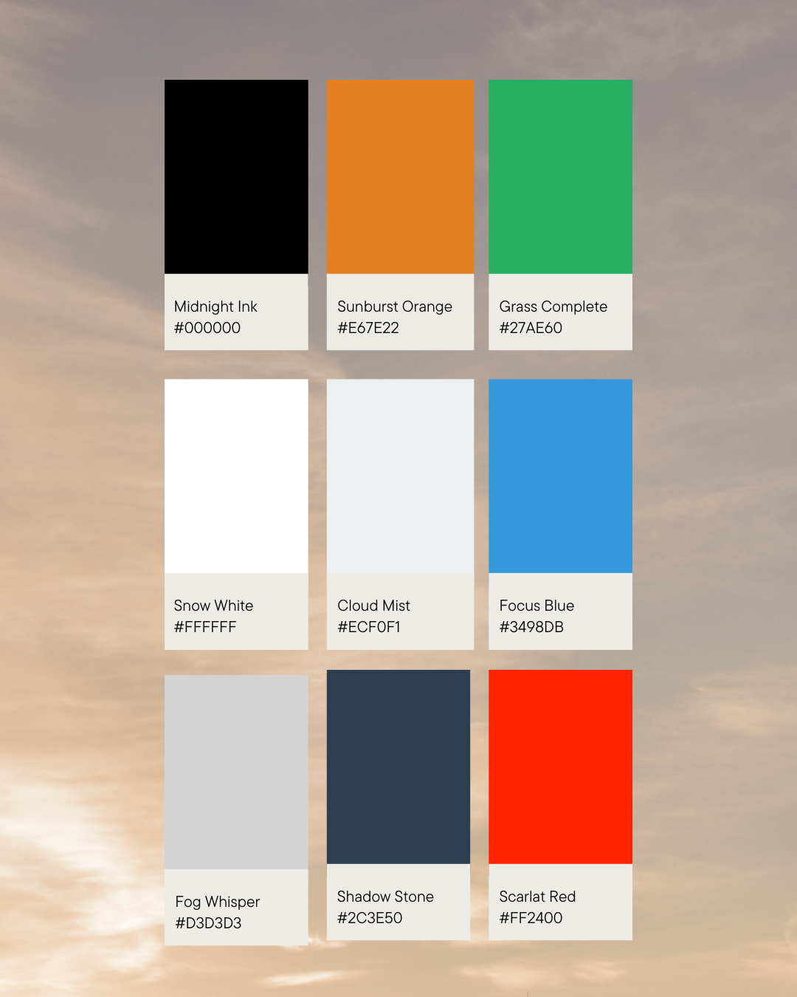
🎨 Design Philosophy 🎨
ASPECT | DETAILS
Function + Form | A visually appealing design ensures to provide an intuitive and aesthetically pleasing interface.
Colour Palette | Calm palette was chosen to promote focus and productivity, aligning with the application’s task management purposes.
Background | Clean backgrounds reduce visual noise and cognitive load, helping users navigate through the tasks and lists in a stress-free environment.
Overall Style | Minimalist and modern approach for having a smooth and enjoyable user experience.
Notes:
The design of the application is as much about function as it is about form. I chose a blue-green colour palette for its calming and productive effect.
The white backgrounds ensure a clean, minimalistic feel, which reduces cognitive load and creates a stress-free environment for users.
The overall design approach aims to enhance usability while keeping the interface modern and visually appealing.

Slide 9
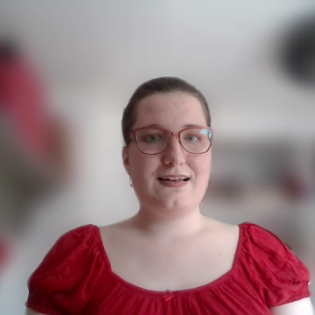
Challenges & Solutions
Notes:
Let’s discuss about the challenges and solutions that I went through.

Slide 10
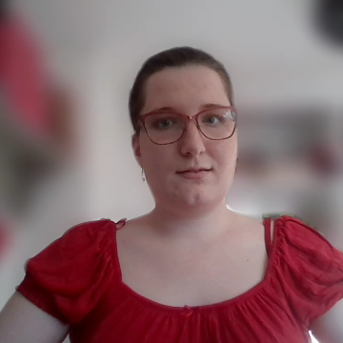
🎯Roadblocks & Breakthroughs 🎯
What Went Wrong
⚠️ Time management was a challenge, especially near the end of the project.
⚠️ Finalizing testing and polishing the code took longer than anticipated due to unexpected errors and bugs.
⚠️ Balancing the project with personal and career uncertainties was difficult.
These challenges helped me improve myself and ask help when I needed the most.
What Went Well
✅ Enjoyment during the development phase.
✅ Confidence to write clean, readable code with meaningful comments.
✅ Unit Testing as a genuine reward, giving me a sense of reassurance.
The growth is noticeable from the first version to the fifth one.
Notes:
What Went Wrong?
One of my biggest challenges was time management.
While coding didn’t take too long, preparing the presentation, finalizing the testing process, and wrapping up the code were harder than expected.
Balancing this project with personal and career uncertainties was also challenging.
These experiences, however, have motivated me to grow stronger in time management
What Went Well?
I was pleasantly surprised by how much I enjoyed coding this time around.
I’ve grown more confident in my ability to write clean, readable code and leave meaningful comments.
Additionally, I found unit testing to be an exciting and rewarding part of the development process—it really gave me a sense of assurance in the application's functionality.

Slide 11
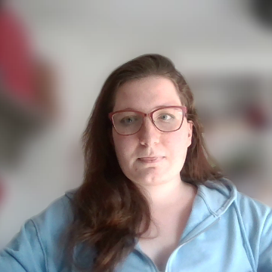
Conclusion
Notes:
This concludes my presentation on the Task Manager application.
I hope you found it clear, well-structured, and informative.
This project was an incredible learning experience for me, and it was fulfilling to see the progress made from the initial version to this much-improved final iteration.
I’ve gained insights into technical development, problem-solving, and self-reflection, which I’ll carry forward in my career.

Slide 12

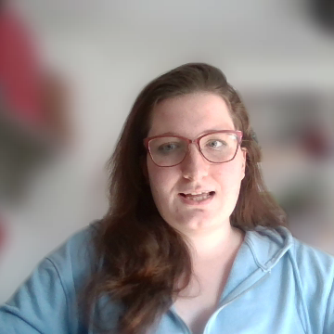
THANK YOU
ViragSzabo
472744
Email-address
Notes:
Thank you for watching my presentation! I look forward to your feedback and the grade this project deserves. Have a wonderful day!

